Slide 1
Mood Disorders

Slide 2
Resources available to you on campus
Baylor Health and Wellness: 254-710-2467
CARE team: 254-710-2100
Suicide prevention hotline: 1-800-273-8255

Slide 3

Major depressive disorder
Characterized by at least one major depressive episode.
A major depressive episode is evident if five or more of the symptoms listed on the next slide:
    Occur for at least 2 consecutive weeks and represent a change from prior functioning.
    Cause significant distress or impairment.
    Are not due to a medical or drug-related condition.
This Photo by Unknown Author is licensed under CC BY

Slide 4
Possible Symptoms of a Major depressive episode
depressed mood
reduced pleasure in activities
substantial loss or gain in weight, without conscious effort, or changes in appetite
sleeping excessively or not sleeping enough
feeling tired
feeling worthless or extremely guilt-ridden
difficulty thinking or concentrating
persistent thoughts about death or suicide

Slide 5
Mdd And Suicide
Recurring depressive episodes increase the likelihood for suicide and health complications.
Signs that someone may be suicidal:
  The person admits thinking about suicide and may even have a plan
  Excessive sadness or moodiness
  Hopelessness
  Sudden calm after a period of excessive sadness
  Withdrawal from social situations
  Engaging in risky or reckless behavior
  If you believe someone is at risk for suicide call the national suicide prevention line: 1-800-273-8255

Slide 6

MDD has a genetic component
Heritability estimates between 37%-50%.
The risk of having this disorder is 2-4 times higher if first-degree relatives are affected.
Twins reared apart have a high concordance rate.

Slide 7
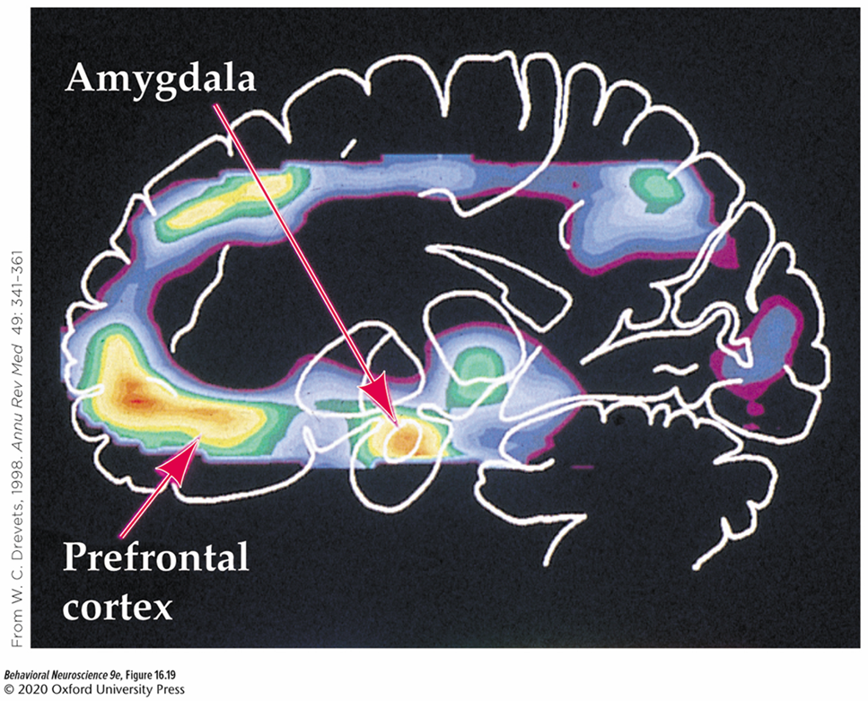
Cortical differences in MDD
Decreased activity in dlPFC, parts of ACC, and posterior parietal and temporal cortex.
  Linked to impaired cognitive control as well as lethargy and fatigue.
  Hemispheric asymmetry: greater right dlPFC activity than left.
Overactivity of Subgenual cingulate cortex.
  May be especially related to somatic and vegetative symptoms.

Slide 8
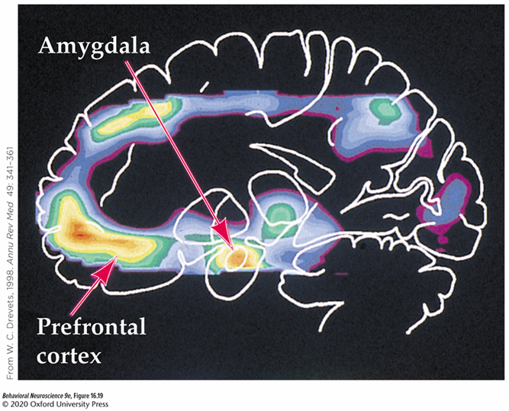
Subcortical differences in individuals with MDD
Overactivity of the amygdala and HPA axis.
  Increased fear and stress responses.
Reduced activity in the nucleus accumbens.
  Linked to apathy, lack of motivation, anhedonia (absence of pleasure).
Reduced activity and size of the hippocampus
  Overgeneralized autobiographical memory and reduced ability to recall positive memories.

Slide 9
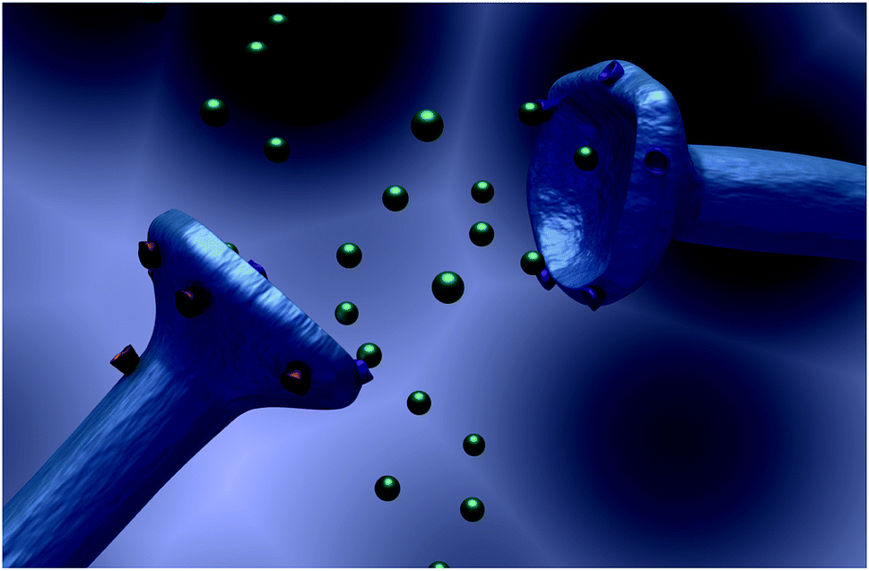
Brain chemistry abnormalities linked to MDD
Reduced levels of monoamine neurotransmitters:
  Serotonin
  Dopamine
  Epinephrine/Norepinephrine
  Acetylcholine
Linked to disturbances of mood, reward, motivation, arousal, and memory.
This Photo by Unknown Author is licensed under CC BY-NC

Slide 10
Treatments for Symptoms of MDD
Antidepressant drugs including:
  Monoamine oxidase inhibitors (MAOIs)
  Tricyclics
  Selective serotonin reuptake inhibitors (SSRIs)
  Second generation antidepressants
Brain stimulation
Cognitive Behavioral Therapy (CBT)

Slide 11
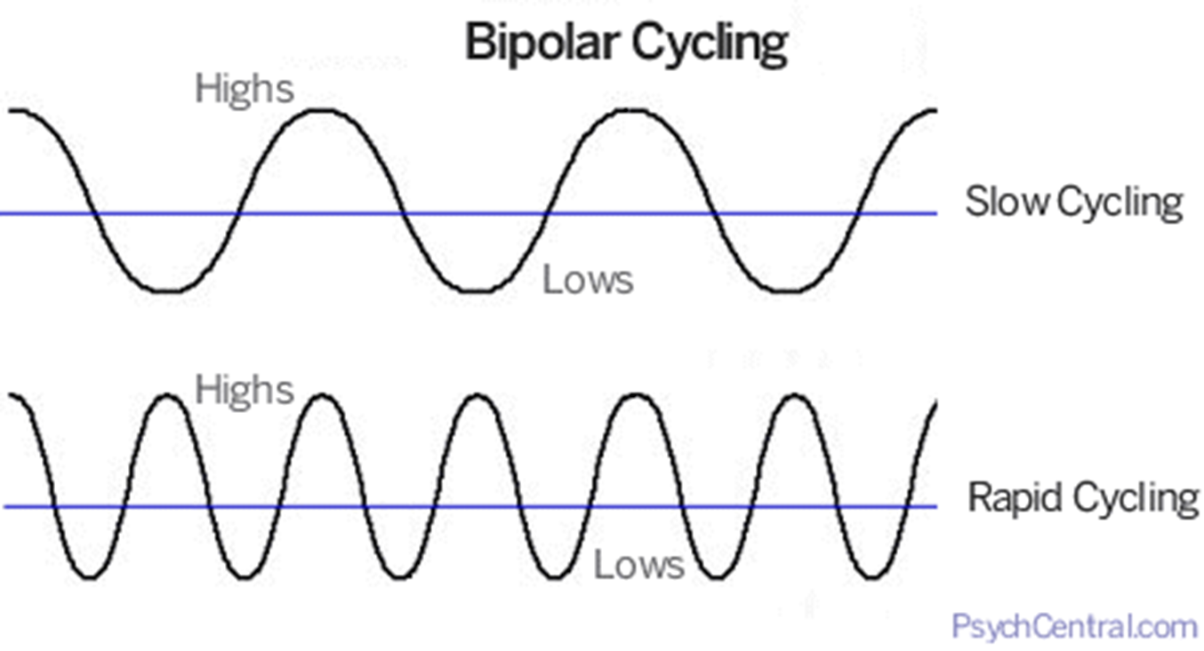
Bipolar disorder (BPD)
Characterized by periods of depression alternating with periods of mania.
Mania may include:
  Sustained overactivity
  Increased talkativeness
  grandiose or extremely high self-esteem
  Increased energy and reduced sleep
  a “flight of ideas” or the feeling of “racing” thoughts
  being easily distracted
  displaying poor judgment and engaging in activities that could have serious consequences
https://g6.psychcentral.com/wp-content/uploads/2018/02/bipolar_cycling_psychcentral.gif

Slide 12
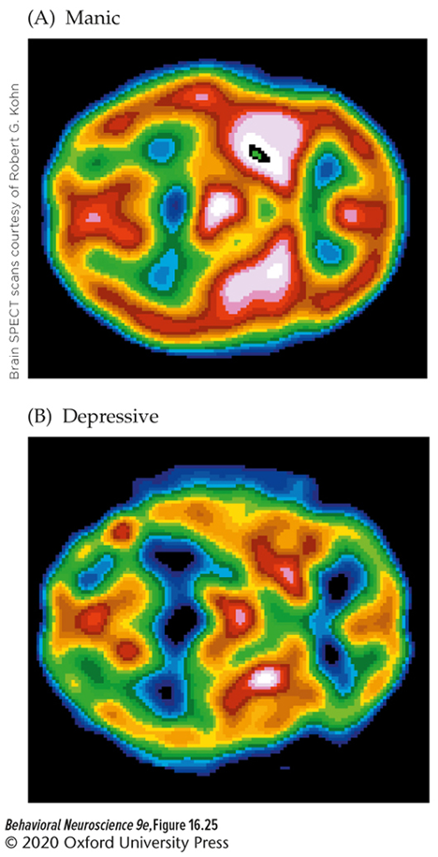
Biological factors that contribute to BPD
Heritability is between 79%-90%, suggesting a role for genetics.
Enlarged ventricles
  Decrease in gray matter in the temporal lobe and cerebellum.
Brain imaging shows more activity globally during manic episodes.
Treatment with lithium tends to be most effective.

Slide 13

Posttraumatic stress disorder (PTSD)
Characterized by exposure to or being threatened by an event involving death, serious injury, or violence followed by trauma related symptoms
This Photo by Unknown Author is licensed under CC BY-NC-ND

Slide 14
PTSD Diagnostic Criteria
The individual must have experienced at least one of the following symptoms:
  Distressing, disturbing, and spontaneously recurring memories of an event
  Dreams with content or emotions associated with the event
  “dissociative reactions” that include feeling as if the event is happening again
  Extreme psychological distress when reminded of the event
  Obvious physical reactions to cues related to the event.

Slide 15
Other Possible Symptoms of PTSD
Difficulty remembering the details of the event
Ongoing self-blame
Depression
Irritability or aggressive behavior
Trouble sleeping or concentrating

Slide 16
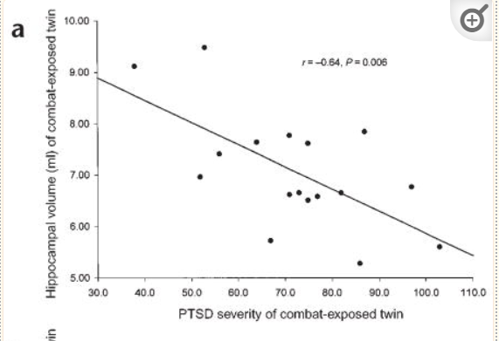
Biological factors that contribute to PTSD
Not everyone exposed to trauma will develop PTSD, suggesting a genetic predisposition for PTSD.
  Reduced volume of the hippocampus is correlated with development of PTSD
Amygdala contributes to classical conditioning of fear.
Gilbertson et al., 2002

